Slide 1
Arizona’s First
Employment First Team & Community Conversation
Jessica Winchester, MBA, ACRE
Gina Griffiths, MSW
July 14, 2025
Notes:
Welcome – our purpose today is to meet Arizona’s First Employment First Team and learn how we are working to move Employment First principles from theory to action by fostering collaboration, building capacity, and creating innovative solutions that empower individuals with disabilities to achieve competitive integrated and meaningful employment. This session will be interactive as we seek your input to drive our work!

Slide 2
Agenda
Meet the Employment First Team
Overview of the Employment First Project
Advance Employment First – Community Conversation
  Share your thoughts!
Stay engaged
Notes:
Timeline for presentation:
10:00-10:05 session housekeeping, welcome, agenda, and intro to Jessica and Gina (slides 1-3)
10:05-10:10 EF project overview (slides 4-6)
10:10-10:55 ground rules and 3 discussion questions – 10 minutes each (slides 7-11)
3 minutes for intro, ground rules
2 minutes for word cloud
10 minutes in each breakout room with 2 minutes to report out one main theme from each group
10:55-10:58 Final thoughts on focus group, stay engaged, wrap up the topic (slide 12)
10:58-11:00 Closing for the session, invite to future sessions (slide 13)

Slide 3

Meet AZ’s First Employment First Team
Employment First Program Manager
  Jessica Winchester, MBA, ACRE
Employment First Coordinator
  Gina Griffiths, MSW
Notes:
Engage with the Employment First Team to learn about their roles, experiences, and expertise in furthering the Employment First initiative, in Arizona and nationally.

Slide 4
AZ’s Employment First Project
Vision: employment is the first and preferred option for all individuals with disabilities.
We are committed to move Employment First principles from theory to action
Dismantle barriers, amplify strengths, and promote a diverse workforce.
Ensure that every individual can contribute to and thrive within their community, making employment not just an aspiration, but a reality for all.
Notes:
Understand the goals and strategies of the Employment First Project in order to collaborate and engage with resources, partners and opportunities to increase CIE outcomes for Arizonans.
Our vision is to transform Arizona into a state where employment is the first and preferred option for all individuals with disabilities.
We are committed to move Employment First principles from theory to action by fostering collaboration, building capacity, and creating innovative solutions that empower individuals with disabilities to achieve competitive integrated and meaningful employment.
Through partnerships with stakeholders, we aim to dismantle barriers, amplify strengths, and promote a diverse workforce.
By prioritizing inclusive practices, we seek to ensure that every individual can contribute to and thrive within their community, making employment not just an aspiration, but a reality for all.

Slide 5
AZ Employment First
Implementation Strategies
Collaboration
Data-Driven Decisions
Building
Communication
Notes:
Collaboration: Build partnerships with key stakeholders like ADDPC, Arizona APSE, and local employers to co-develop resources and initiatives.
Data-Driven Decisions: Use surveys and feedback from trainings and focus groups to continuously improve strategies and materials.
Building: Onboard and train new staff (e.g., EF coordinator) to strengthen implementation capacity.
Communication: Maintain transparency with stakeholders through regular updates, newsletters, and accessible materials.

Slide 6
AZ Employment First Activities and Actions
Training & TA
Outreach
Engage employers
Solicit feedback
Statewide leadership and coordination
Share information
Notes:
Training, technical assistance, & events
Outreach to families, youth, community members, providers, schools, employers, agencies, and other stakeholders
Engage employers in partnership with organizations
Solicit feedback from all stakeholders (focus groups & surveys)
Statewide leadership and coordination
Maintain the AZ Employment First website

Slide 7
Create the Conversation
Here’s how you can participate today:
Speak up during discussions – raise your hand or unmute when invited
Use the Menti app for our first question
Join breakout conversations – small group time helps everyone get heard
Drop your ideas in the chat at any time
Prefer to share later? Email us anytime at EmploymentFirst@Arizona.edu
Notes:
Provide feedback and offer your insights to shape the ongoing work of the Employment First Initiative in Arizona.
This is a conversation without shame or blame.
We are not here to judge – we are here to listen.

Slide 8
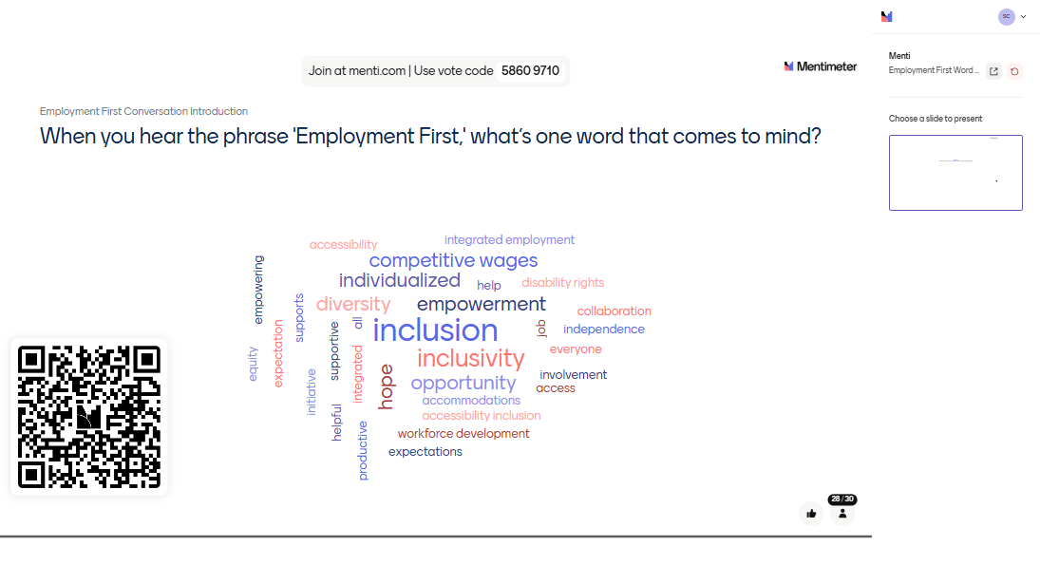
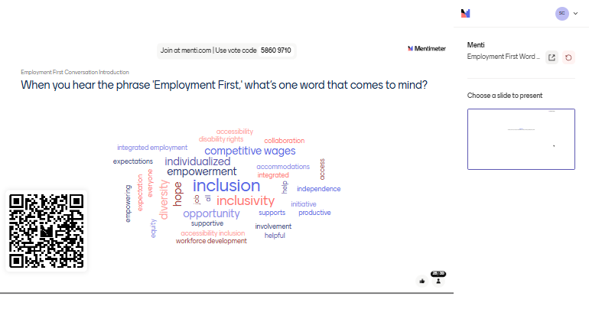
Notes:
Explain how to use Menti if needed. Open for 2 minutes.

Slide 9
Employment First Conversation 1
What would success look like, for you or your community, if Employment First worked the way it should?
Notes:
Use 2–3 person breakout rooms and have each group report back

Slide 10
Employment First Conversation 2
Can you share a story or example of when someone in your community wanted to work but ran into challenges?
Notes:
Use 2–3 person breakout rooms and have each group report back

Slide 11
Employment First Conversation 3
If we could only focus on one thing over the next year to improve employment outcomes, what should it be and why?
Notes:
Use 2–3 person breakout rooms and have each group report back

Slide 12
How can you stay engaged?
Visit the Sonoran Center Employment First page – https://sonorancenter.arizona.edu/azemploymentfirst
Join monthly Employment First Topics & Tactics – https://sonorancenter.arizona.edu/events/employment-first-topics-tactics
Join Arizona APSE – https://www.azapse.org/

Slide 13
The Sonoran Center Employment First Team
Jessica Winchester, MBA, ACRE
  Employment First Project Manager
  winchesterj@arizona.edu
Gina Griffiths, MSW
  Employment First Coordinator
  griffiths@arizona.edu
EmploymentFirst@Arizona.edu

