Slide 1
Outbound Training Series: Promoting Employment in Uganda
Training 3: Technology Use and Virtual Communication
Elizabeth Jeffrey-Franco, MPH
July 10, 2023

Slide 2
WELCOME
Introduction
Overview of today’s session

Slide 3
AGENDA
Plain Language and Easy Read
Accessible Digital Design
Virtual Communication Channels and Strategies

Slide 4
Principles for creating accessible resources.
Use simple words
For example:
These words tell a story using only the ten hundred words people use most often. Even though the words aren't hard, you can talk about hard ideas. Easy words can help you talk about hard ideas and let more people understand. You can try to do the same thing with the Up-Goer Five.

Slide 5
Principles for creating accessible resources.
Reduce idea density (the amount of ideas per sentence)
For example:
Members of Congress (your Representative and your Senators) have a national office in Washington, D.C. and one or more offices in the state they're from.
Your Representative and your Senators are your Members of Congress.
Members of Congress have more than one office.
Each Member of Congress has one national office in Washington, D.C.
They also have one or more offices in the state they are from.

Slide 6
Principles for creating accessible resources.
Cognitive accessibility is not about cutting out information, it’s about conveying complex information in a simple way.

Slide 7
Complex sentence
Many autistic students have expressed difficulty accessing information regarding receiving disability accommodations.
Complex idea removed
Many autistic students say it is
hard to get information.
Complex idea explained
Many autistic students say it is hard to get information about accommodations.
Accommodations are changes that make things easier for people with disabilities.

Slide 8
Principles for creating accessible resources.
You may need to “back up” to go forward - explain background information to help readers understand your main topic
For example, to write about U.S. Medicaid, you might have to start by explaining things like:
What health insurance is
What kinds of health insurance there are
How the government pays for Medicaid

Slide 9
Principles for creating accessible resources.
Check reading level using tools like Readable or Automatic Readability Checker.
Plain language = 5th-8th grade reading level (depending on who you ask)
Easy Read = 3rd-4th grade reading level

Slide 10
For a great explanation of reading levels and their relationship to readability, check out “What makes writing more readable?” from The Pudding: https://pudding.cool/2022/02/plain/

Slide 11
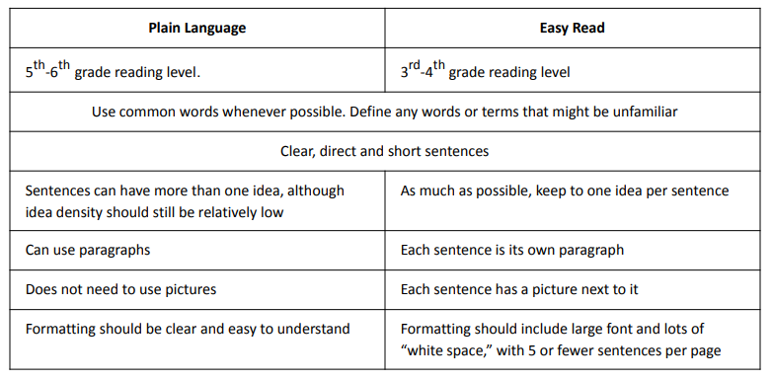

Slide 12
Accessible Digital Design
High Contrast Colors
A strong contrasting color palette helps the important information stand out more clearly.
Font/Typeface
San serif generally preferred. Calibri (used here), Tahoma, Arial, Verdana
Simple icons and photos
An infographic is a great way to display complex information, as you can break the information into simple sections and use icons to illustrate the important points.

Slide 13
Accessible Digital Design
Alternative Text
Are all website/document images properly tagged with alternative text?
Do emails include “text only” versions?
Audio/Visual Transcripts/Captions
Do all audio and video files include transcripts and captions?
Mobile Optimization
Does all your digital content display properly on cell phones?
Notes:
Over half of all global web traffic comes from mobile devices

Slide 14
Virtual Communications
An integrated digital communications strategy increases your reach (and maximizes your resources)
Aim to disseminate content across multiple channels.
Notes:
Examples:
Create infographics for social media? Also embed them on your website. Utilize them in an upcoming webinar presentation. Include them in a digital one pager. People need to see important messages multiple times before information sinks it.
You can host a live webinar and then turn the transcript of that webinar into an article on your website, or edit clips from the webinar to share on social media.
Photos from an event can be shared on social media, then embedded as a photo gallery on your website or incorporated into a web article for anyone to access, and then that web page can be pushed out in your next newsletter.

Slide 15
Virtual Communications
A focus on digital audience-building is critical
Incorporate strategies that allow you to build audiences that you can communicate with over time and re-target with important messaging.

Slide 16
Virtual Communications
Website
“Home” for all information. Can be discovered and accessed 24/7. Must use accessible design practices.
Email opt-in allows you to build an audience for emails/newsletters
Link to your social media accounts
Social Media
Build followers over time by sharing regular content, engaging with other accounts, using hashtags.
Can turn followers into email subscribers by sharing opt-in links
Email/Newsletter
Does all your digital content display properly on cell phones?
HTML newsletter generally considered more accessible than digital PDF newsletter (e.g. MailChimp)
HTML also allows for opt-ins when an email is forwarded
Notes:
Many low-cost website hosts exist – research what is best for your organization
Use “mobile preview” to check

Slide 17
Virtual Communications
Video
Can be an interesting and accessible way to communicate important information.
Can be embedded on website, shared on social, embedded in emails, etc.
Marketing videos should be under 30 seconds (the shorter, the better in terms of engagement)

Slide 18
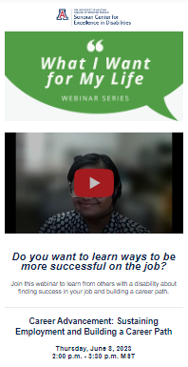
Example
https://mailchi.mp/6d0b769fedca/nativewebinarseries5-13365486?e=[UNIQID]

Slide 19
Virtual Communications
Webinars
Allows for live questions
Content can be edited and repurposed
Best live engagement at <1 hour

Slide 20
Webinars
Zoom Tips
Require registration
Allows you to have participants “opt-in” to receive future emails from you – i.e. helps you grow your email/newsletter audience
Allows you to collect important demographic information that can help you target your presentation
Allows your participants to submit their accommodations in advance
Allows you to push reminders and send follow-up information
Multiple options to participate
Allow for dial-in for participants who might not have reliable internet access
Record and share video after for participants who were unable to attend full session or would like to review content/share with others (make sure video is accessible!)

Slide 21
Webinars
Zoom Tips
Make sessions interactive
Zoom built-in Q&A and polls
Can also use third-party engagement tools like Mentimeter
Common accommodations to be prepared for
Interpreters – sign language or other language
Two interpreters; change places every 15 minutes
Spotlight interpreter as well as active speaker
Suggest that participants use the “side-by-side” view in Zoom so they can slide the toggle to adjust their display
CART Captions – can be turned on or off
Auto-captions are highly inaccurate and not considered accessible
Mixed case has been demonstrated as being easier to read than all caps
Share PowerPoints and any planned videos with interpreters and captioners in advance
Verbal descriptions of speakers and presentations
Participants may also ask that you share PowerPoint decks in advance (make sure deck is accessible!)

Slide 23
“The power of the [internet] is in its universality. Access by everyone regardless of disability is an essential aspect.”
—Sir Tim Berners-Lee, inventor of the World Wide Web

Slide 24
Contact
Elizabeth Jeffrey-Franco
elizabethjeffrey@arizona.edu

